Slide 1
Clinical Build Map
PROGRAM NAME HERE

Slide 2
TABLE OF CONTENTS
Outcomes – pg. 2
Devices – pg. 3
Introduction to Conversations – pg. 4
Conversation Examples – pg. 5
Incidents – pg. 6
Keywords – pg. 7
Personnel – pg. 8
APPENDIX
Best Practices – pg.9– 10
Example Conversation – pg. 11
Tip Sheets for Staff – pg. 12 – 13

Slide 3
OUTCOMES
2
What are the three top aims or desired outcomes for this program? What do you hope to achieve for your patients and staff? We’ve included an example below in grey.
Problem Statement What issue do you want to change? | Desired Change What outcome(s) do you desire to see? | Metrics How will success be measured?
Only 30% of eligible patients are scheduling mammogram screenings. | Increase uptake of screening mammograms among eligible patients. | Number of mammogram appointments created and attended.

Slide 4
DEVICES
3
Programs can use devices to collect data (i.e., BP Cuffs, pill bottle, etc.).
We’ve included an example below in grey. If your program does not plan to use a device, please skip to the next section.
Device Name | Cadence How often is data collected | Repeats How many days is data collected?
i.e., Digital Scale | i.e., once a day, 7 days a week | i.e., 64 days

Slide 5
CONVERSATION - INTRODUCTION
4
Conversations
Way to Health allows users to engage in bi-directional conversations with patients. Conversations can be configured to trigger specific outcomes depending responses and can be scheduled for a particular date/time or initiated when a patient texts in a keyword.
Use the Key and Conversation Flow (to the right) and the Conversation Example (pg. 4) to plan your program’s conversations.
KEY
CONVERSATION FLOW
START/ END
Every conversations has a start and an end point (sometimes referred to as the conversation window). Use this shape to identify both moments.
Start
X days from start at X time
OUTGOING TEXT
This shape is used for questions or prompts, often things that must be responded to.
OUTGOING TEXT
PATIENT RESPONSE
This shape indicates a response from a patient.
This shape is used to indicate when an incident or alert is sent to staff.
PATIENT RESPONSE
PATIENT RESPONSE
This shape is used to indicate when a participant texts in a keyword.
1
OUTGOING TEXT
SURVEY
SURVEY
This shape is used for surveys, sent to patients or staff.
Text in curly brackets { } indicates that a pre-populated variable is piped into a message.
End
X days or hours later at X time
{ VARIABLE }

Slide 6
EXAMPLES
CONVERSATION EXAMPLE
5
*
Update this conversation with your own language and logic.
Day 1 - 9:00 am
Great! You're overdue for bloodwork to help control your diabetes. We have reserved these labs for you.
Text 1 for info to schedule or 2 if you are not interested.
Please walk into any Penn Lab at your earliest convenience. If you prefer an appointment, call {PHONE_NUMBER} or use the myPennMedicine online portal.
If you need to get your labs drawn outside of Penn, text MAIL and we will mail you lab slips, or CALL and we will call you.
{ADDRESS}
Text 1 if this is your correct address. If not, please respond with the correct one.
Thanks! We'll update our records
MAIL
UPDATE ADDRESS
Hi {PATIENT_NAME} this is a message from PCP’s office at Penn Medicine. We're alerting you to a new text-based program which helps manage one of your health conditions.
Text NOT ME if we contacted the wrong number, or BYE if you don't want to receive messages about the program.
Please note texting is not 100% secure. Msg & data rates may apply.
1
5
2
4
CALL
We're happy to help. Please expect a call within 2 business days.
3
1 Month Later – 9:00 am
Thanks for your response. Please let us know why you aren't interested in getting bloodwork done at this time. Text back one of the following numbers:
1) No longer a patient of the practice
2) I work with a diabetes doctor
3) Not a priority now
4) Other → free text
1
Remove patient from PCP list
Hi again {PATIENT _NAME}, this is {PCP}’s office at Penn Medicine. Just a reminder that you’re overdue for bloodwork to help control your diabetes. We have reserved these labs for you. Text 1 for info to schedule or 2 if you are not interested.
Thanks for your input. You can call {PCP}’s office at {PHONE_NUMBER}. with any ongoing issues.
2
3
Thanks for letting us know. Would you like us to reach out again in a month? Text 1 for yes or 2 for no
1
1
2
NOT ME
BYE
4
Thanks for your input. You can call PCP’s office at {PHONE_NUMBER} with any ongoing issues.
Please text us why you aren’t interested at this time.
We apologize for the inconvenience
1
Incident Example
Wrong Number: PARTICIPANT_NAME seems to have a wrong phone number on record.
FEEDBACK

Slide 7
INCIDENTS
6
Incidents are alerts sent from W2H to an EPIC pool or staff email address
Incident Name | Incident Language | Cadence | Epic Pool ID & / Email
Critically High BP | PARTICIPANT_ID has a critically high BP of {blood_pressure}. | Sent immediately via Epic Pool / staff email account

Slide 8
KEYWORDS
7
Keywords texted in by patients can send a response and or trigger an outcome.
Keyword | Response | Outcomes
Call | During Business Hours: I’m sorry to hear that. A care team member will be calling you within 30 minutes. After Hours: Our care team is out of the office. Call your Primary Care Physician/Pulmonologist. If you are having extreme difficulty breathing, please call 911. | Generate Call Incident or Call (off hours) Incident

Slide 9
PERSONNEL
8
Learn more about roles and permissions for personnel in our user guide.
Name | Email | Role | Epic ID | Access Group *
Sarah Mazer | sarahemail@fake.edu | Provider | smfake | Jefferson
*
If your program has multiple sites and you need to control which staff member has access to a patient’s data, include the name of their site in the Access Group column.

Slide 10
APPENDIX – BEST PRACTICES
10
Consent-based participation is a key part of any program’s workflow.
OPT - OUT
Opt-Out - When enrolling patients individually This entails verbally educating/informing a patient about the texting program and getting their verbal consent (i.e., they say yes or no to the program). If the patient says yes, they are enrolled into the texting program and given an initial text on how to opt-out.
A written record should be kept in the patient’s chart to document they verbally consented to being a part of the program (i.e., through a dot phrase in an Epic encounter).
Hello,
PARTICIPANT_FIRSTNAME, thank you for enrolling in PROGRAM_NAME. We’d like to check-in on you over the next 2-weeks to monitor your symptoms. Texting isn’t 100% secure and msg/data rates may apply.
Text “Bye” to stop receiving these messages.
BYE
*
If a patient texts in Bye, plan to send a message back to them recognizing this and then mark them as declined or un-enrolled.
Thank you, we will no longer text you regarding this program.

Slide 11
APPENDIX – BEST PRACTICES
9
Consent-based participation is a key part of any program’s workflow.
OPT - IN
Opt-In- When bulk enrolling patients Use this approach for outreach programs where a patient can not be consented in-person. Send patients an initial text asking them if they’d like to participate in the program. The patient’s response is stored securely in Way to Health.
Hi, PARTICIPANT_FIRSTNAME PARTICIPANT_LASTNAME_INITIAL, this is a message from Penn Medicine. We are inviting you to a text message program for your health. Please text YES to confirm you are PARTICIPANT_FIRSTNAME and learn more about the program. Text NO if this is not you. Texting is not 100% secure. Msg & data rates may apply.
NO
YES
Thank you, we will no longer text you regarding this program.
*
If a patient texts in No, plan to send a message back to them recognizing this and then mark them as declined or un-enrolled.

Slide 12
APPENDIX – EXAMPLE CONVERSATION
11
Start: day 30 9:00 AM
2
Thank you for completing your monthly check-in.
Your {MEDICATION_NAME} prescription will arrive on {DELIVERY_DATE}
If you have any questions or concerns about your medication, please call {PHONE_NUMBER}.
Great - Your co-pay will be ${CO-PAY} and you will receive your bill in the mail.
To complete your refill please reply GO. To discuss your co-pay with one of our pharmacy technicians before moving forward reply ASSIST or call us at {PHONE_NUMBER}.
GO
ASSIST
1
Alerts sent to pool or staff email
ASSIST
GO
1. Assistance: PARTICIPANT_ID reported that they have a co-pay issue. Please follow up with them directly.
2. Completion: PARTICIPANT_ID completed the Payment Confirmation conversation.
Ok, a pharmacy technician will be reaching out to you within 1 business day. You can also call us at {PHONE_NUMBER}.
End: 3 days later

Slide 13
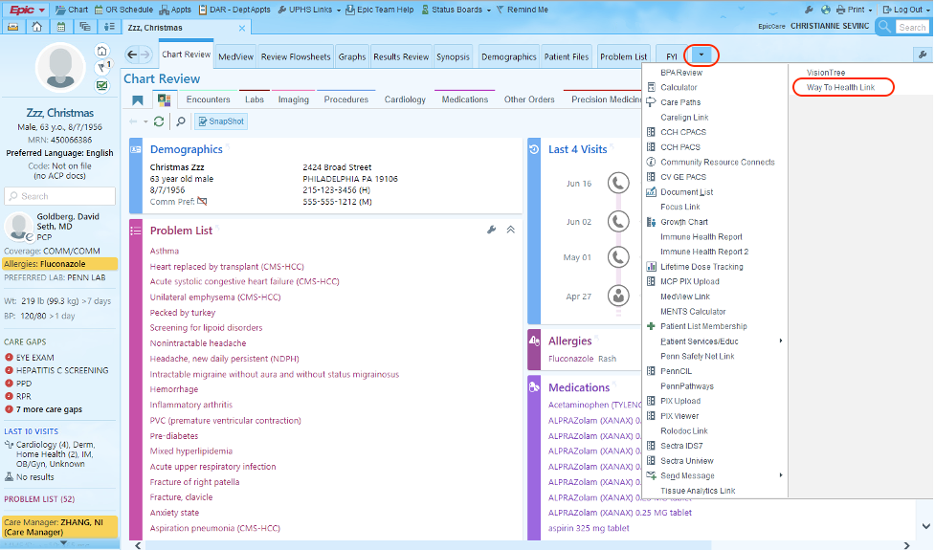
APPENDIX – ACCESSING WAY TO HEALTH IN EPIC
12
Select a patient's chart, or to enroll in the context of an encounter, open Appts, the OR Schedule, or DAR.
Click the last tab to expand the menu.
1
2
3
From that menu, select the Way To Health Link.

Slide 14
APPENDIX – FINDING & REQUESTING ACCESS TO YOUR PROGRAM IN EPIC
13
*
If you are not yet listed as personnel in W2H, you will need to request access prior to enrolling patients.
From the embed, use the search bar to locate your program.
1
Click the Request Access button. This will send a message to the program's manager to approve request.
Until approval is granted, you will see “pending” next to that program.
2

